Slide 1
Inverse Kinematics and Particles
Grant Smith 40111906
Physics-based Animation

Slide 2
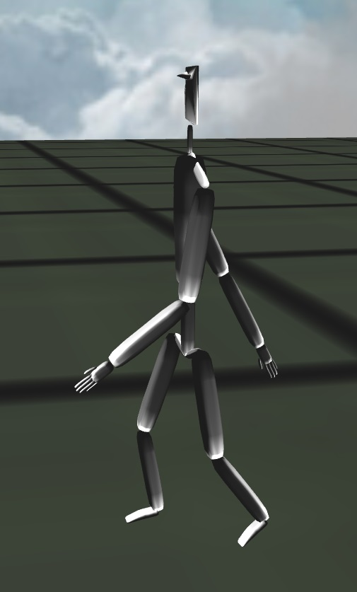
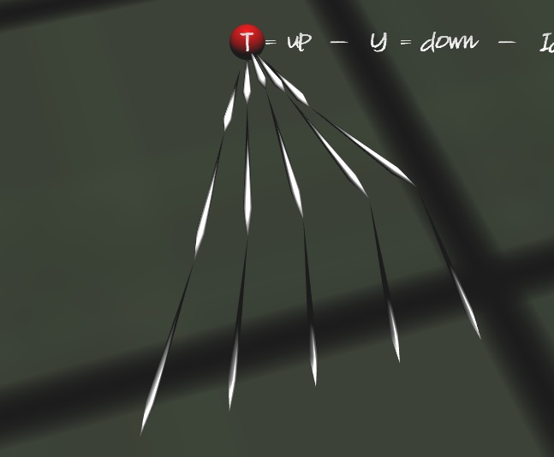
Inverse Kinematics
Implemented using the CCD method
Angle Limits
Reach Limits
Procedural Animation

Slide 3
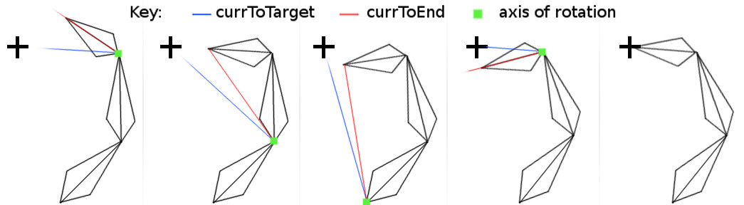
Cyclic Coordinate Descent (CCD)
Simple
Fast
Iterative
Process:
Get the axis of rotation (cross product)
Get the angle to rotate (acos + dot product)
Create a quaternion from the axis and angle
If the quaternion is within the angle limits
Rotate the link
After this is done for each link, apply the rotation from the root link down to the last child

Slide 4
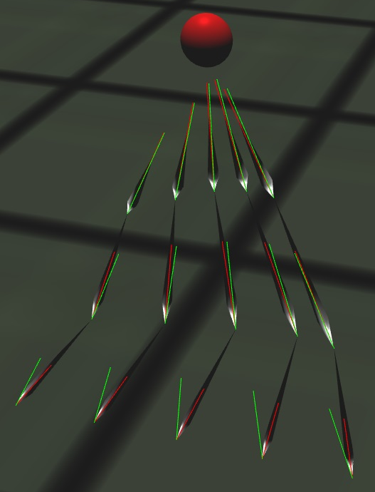
Inverse Kinematics Testing
To test the Inverse Kinematics:
Create a point to follow
Rotate that point randomly around every axis (x, y, z)
If it can reach
It should always work
If it can’t reach
It doesn’t work

Slide 5
Collision Detection
Sphere v Sphere
AABB v AABB (Axis Aligned Bounding Box)
OBB v OBB (Orientated Bounding Box)
Line v Line
Sphere v Plane
Other combinations will not be covered since they are mostly derivatives of the above

Slide 6
Sphere v Sphere
Offset vector from sphereA and sphereB
Take the magnitude of the offset
If the sum of the radii is less than the magnitude
There is an intersection
If the sum of the radii is less than the magnitude
No Intersection
Sphere A
r
offset
r
Sphere B

Slide 7
AABB v AABB
For each axis: x, y and z
Check centre[axis] of cubeA – centre[axis] of cubeB is less than
The sum of the dimension of each cube on that axis
If the check is true on each axis then there is an intersection
Centre
(x, y, z)
Dimension
(x, y, z)
cubeA
Centre
(x, y, z)
Dimension
(x, y, z)
cubeB

Slide 8
OBB v OBB
cube0.normals[0],
cube0.normals[1],
cube0.normals[2],
cube1.normals[0],
cube1.normals[1],
cube1.normals[2],
cross(cube0.normals[0], cube1.normals[0]),
cross(cube0.normals[0], cube1.normals[1]),
cross(cube0.normals[0], cube1.normals[2]),
cross(cube0.normals[1], cube1.normals[0]),
cross(cube0.normals[1], cube1.normals[1]),
cross(cube0.normals[1], cube1.normals[2]),
cross(cube0.normals[2], cube1.normals[0]),
cross(cube0.normals[2], cube1.normals[1]),
cross(cube0.normals[2], cube1.normals[2])
normalize(cube1.position - cube0.position)
Centre
(x, y, z)
Take the 3 normal of two cubes (ignoring normals that are the negative of another)
Add them to a list called ‘axes’
Take the cross of each normal from the first cube and each normal from the second cube
Add them to ‘axes’
Add the normalized offset of the cubes to the list as well ‘axes’
Get the corners of both cubes and add them to a list called ‘corners’
Dimension
(x, y, z)
Rotation
(4x4 Matrix)
3 Normals
(x, y, z)

Slide 9
OBB v OBB (cont.)
For every axis in the ‘axes’ list
Do a 1D intersection test
If at any point, the 1D intersection is false, there is no intersection = no collision
If each test returned true, pick the test that returned the lowest overlap and use the axis for that as the collision direction
1D intersection test:
Take the dot product of the axis against each corner (for both cubes)
Store the min and max value from the dot product for each cube
Calculate the longSpan = fmax(max0, max1) - fmin(min0, min1)
Calculate the sumSpan = max0 - min0 + max1 - min1
If the long span is less than or equal to the sum span, there is an overlap on the axis

Slide 10
Line v line

Slide 11
Sphere v plane

Slide 12
Particle System

Slide 13
Spatial Partitioning

Slide 14
Rigid Bodies – linear dynamics

Slide 15
Improvements

